Slide 1

RUHR-UNIVERSITÄT BOCHUM
DEMAND & SUPPLY IN ENERGY MARKETS · GROUP PROJECT · INTERMEDIATE PRESENTATION
Evaluating Germany’s Proposed Capacity
Mechanism “Kraftwerksstrategie”
A two-layer evaluation, a capacity-mechanism (CRM) literature review, plus a PyPSA dispatch model of the 2030 German power system, built on authentic official data.
GROUP MEMBERS
PROJECT AT A GLANCE
Focus: Germany’s Kraftwerksstrategie (a CRM)
Method: PyPSA single-node dispatch · HiGHS solver
Horizon: Hourly, 8760 h · calibrated 2025 → 2030
Data: Energy-Charts (SMARD / ENTSO-E), official targets
Group member | Matriculation no.
Muhammad Ahmad Khan | 108024110422
Muhammad Zaryab Mehdi | 108023241872
Ateeq Ur Rehman | 108023237579
Haseeb Abid | 108024103831
Ruhr-Universität Bochum · Chair of Energy Systems & Energy Economics · Kraftwerksstrategie · June 2026
1 / 7

Slide 2
PART 1 · LITERATURE | MOTIVATION
Overarching Research Question
RESEARCH QUESTION
In 2030, how does adding the Kraftwerksstrategie’s firm capacity (≈ 10 GW of new H₂-ready gas) change Germany’s security of supply, wholesale prices, gas-fleet utilisation and CO₂ emissions?
Why it matters now
▪ Firm, controllable capacity is leaving the system: nuclear phased out (2023); coal exiting under the Coal-Exit Act (KVBG).
▪ Weather dependent wind & solar scale fast toward the EEG-2023 target of 80 % renewables by 2030.
▪ A cold, dark, windless evening must still be covered by firm capacity.
▪ An energy only market may under reward new firm plants → the “missing-money” problem.
The policy in one line
The Kraftwerksstrategie pays for availability (not energy) of ≈ 10 GW new H₂-ready gas → a capacity remuneration mechanism (CRM).
Four outcomes we test:
Security of supply
Wholesale prices
Gas-fleet use
CO₂ emissions
Ruhr-Universität Bochum · Chair of Energy Systems & Energy Economics · Kraftwerksstrategie · June 2026
2 / 7

Slide 3
PART 1 · LITERATURE
Literature Review and the Research Gap
Part 1 uses cited academic & policy sources only → no model numbers → to summarize what CRM theory predicts and to locate the gap this study fills.
What the CRM literature finds
▪ “Missing money”: energy-only markets under-reward firm capacity; price caps truncate scarcity rents (Cramton & Stoft 2005; Joskow 2008).
▪ CRMs cut price spikes & volatility, shifting income from energy rents to stable capacity payments (Bublitz et al. 2019).
▪ CRMs improve adequacy and damp the investment cycle, but add capacity & consumer cost; sensitive to the target volume (Bhagwat et al. 2017).
▪ Interconnectors are partial substitutes for capacity; “missing markets” justify forward auctions (Newbery 2016).
▪ Market-wide payments can hand windfalls to incumbents; reliability options curb this (European Parliament 2017).
The research gap
▪ Most CRM evidence is generic or pre-dates Germany’s 2030 fleet, yet results depend strongly on system specifics.
▪ The Kraftwerksstrategie is very recent (EU agreement 15 Jan 2026): little quantitative, system-specific evaluation exists yet.
▪ Few studies offer an hourly, reproducible, authentic-data test of this policy’s effect on German 2030 prices and adequacy.
→ This study fills the gap: an hourly PyPSA dispatch model on official data that quantifies the +10 GW for the German 2030 system (Part 2).
Ruhr-Universität Bochum · Chair of Energy Systems & Energy Economics · Kraftwerksstrategie · June 2026
3 / 7

Slide 4
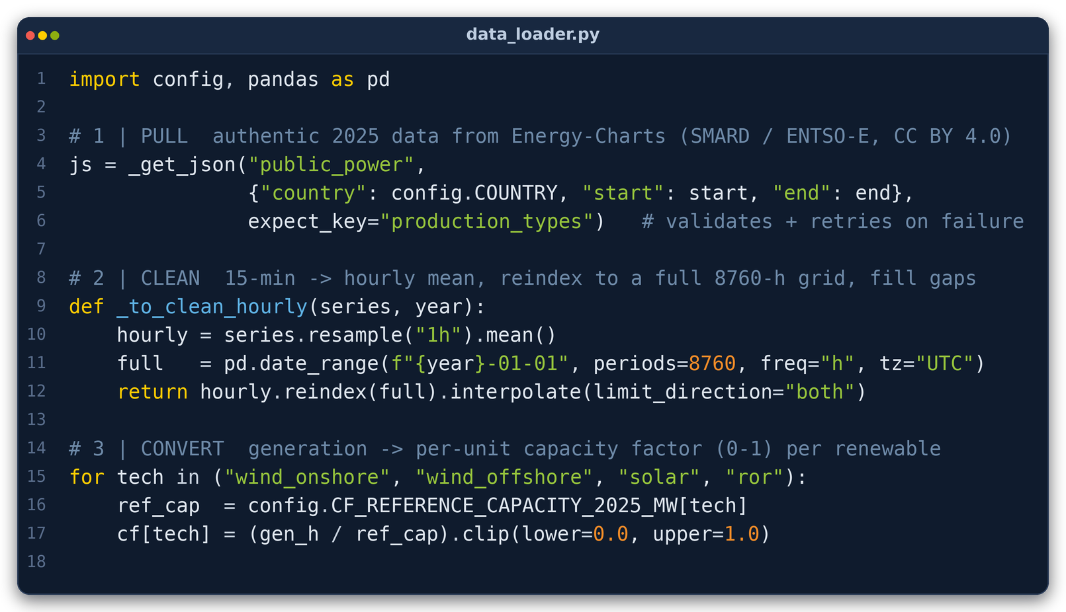
PART 2 · METHODS & WORK PLAN | STEP 1 → DATA
Data Pipeline → data_loader.py
What it does: downloads real, official 2025 German power data and turns it into the clean hourly inputs the model needs.
1 · PULL authentic 2025 data from the Energy-Charts API (re-publishing SMARD / ENTSO-E, CC BY 4.0): hourly load, generation per type, day-ahead price.
2 · CLEAN resample 15-min → hourly, reindex to a full 8 760-hour grid, and fill any gaps.
3 · CONVERT turn renewable generation into per-unit capacity factors (0→1) and log full provenance (source, URL, units, date).
WHAT IT GIVES US
demand_2025_hourly.csv
cf_2025_hourly.csv
price_2025_hourly.csv
generation_2025_hourly.csv
Core of data_loader.py: pull → clean → convert.
provenance.json
Fully reproducible.
Ruhr-Universität Bochum · Chair of Energy Systems & Energy Economics · Kraftwerksstrategie · June 2026
4 / 7

Slide 5
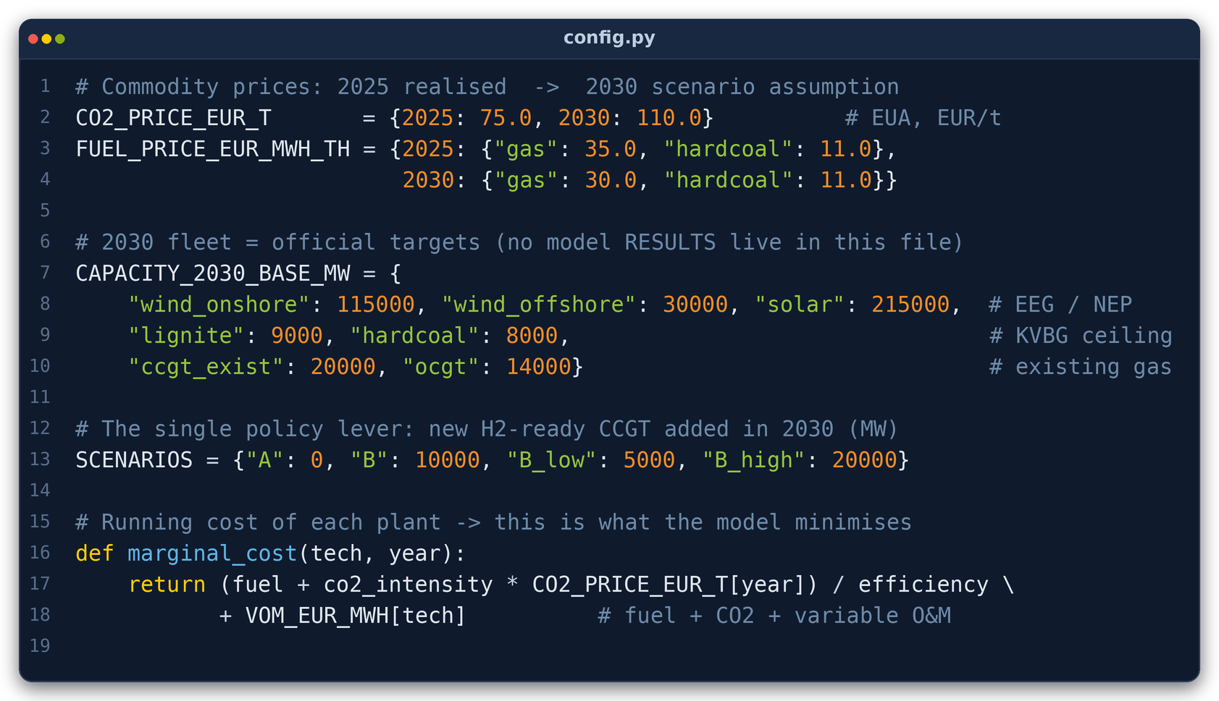
PART 2 · METHODS & WORK PLAN | STEP 2 → KEY DATA AND ASSUMPTIONS
Assumptions & Projection → config.py
config.py holds every parameter (each source-tagged; zero hard-coding in the model). Two layers: 2025 calibration vs the 2030 target year. The 2030 fleet is adopted from official targets → not forecast.
HOW THE DATA IS PROJECTED · 2025 → 2030
Parameter | 2025 | 2030 | Source
Gross demand | 466 TWh* | 680 TWh | NEP Szenariorahmen 2025
Solar PV | 100 GW | 215 GW | EEG-2023 / NEP
Wind onshore | 63 GW | 115 GW | EEG-2023
Wind offshore | 9.2 GW | 30 GW | WindSeeG / NEP
Lignite | 15 GW | 9 GW | KVBG (coal exit)
Hard coal | 13 GW | 8 GW | KVBG (coal exit)
Battery storage | 2 GW | 25 GW | NEP 2025
CO₂ (EUA) price | 75 €/t | 110 €/t | NEP / Langfristsz.
New H₂-ready CCGT | 0 GW | +10 GW | BMWE (Scenario B)
2025 = authentic measured load (Energy-Charts). We do not forecast 2030: we adopt legal/official values → EEG-2023 & WindSeeG (renewables), KVBG (coal ceiling), NEP 2025 (demand, storage, CO₂), BMWE (the +10 GW).
The 2025 hourly weather & demand shapes are reused: demand scaled to 680 TWh; renewable capacity factors re-scaled to the 2030 fleet.
COSTS INCLUDED
Fuel, CO₂ (EUA), variable O&M, scarcity at VOLL 3000 €/MWh, annualized CAPEX + fixed O&M of the new CCGT.
COSTS EXCLUDED
sunk CAPEX of existing fleet & renewables, grid/network & redispatch (single node), start-up/ramping, taxes, levies, retail margins.
Ruhr-Universität Bochum · Chair of Energy Systems & Energy Economics · Kraftwerksstrategie · June 2026
5 / 7

Slide 6
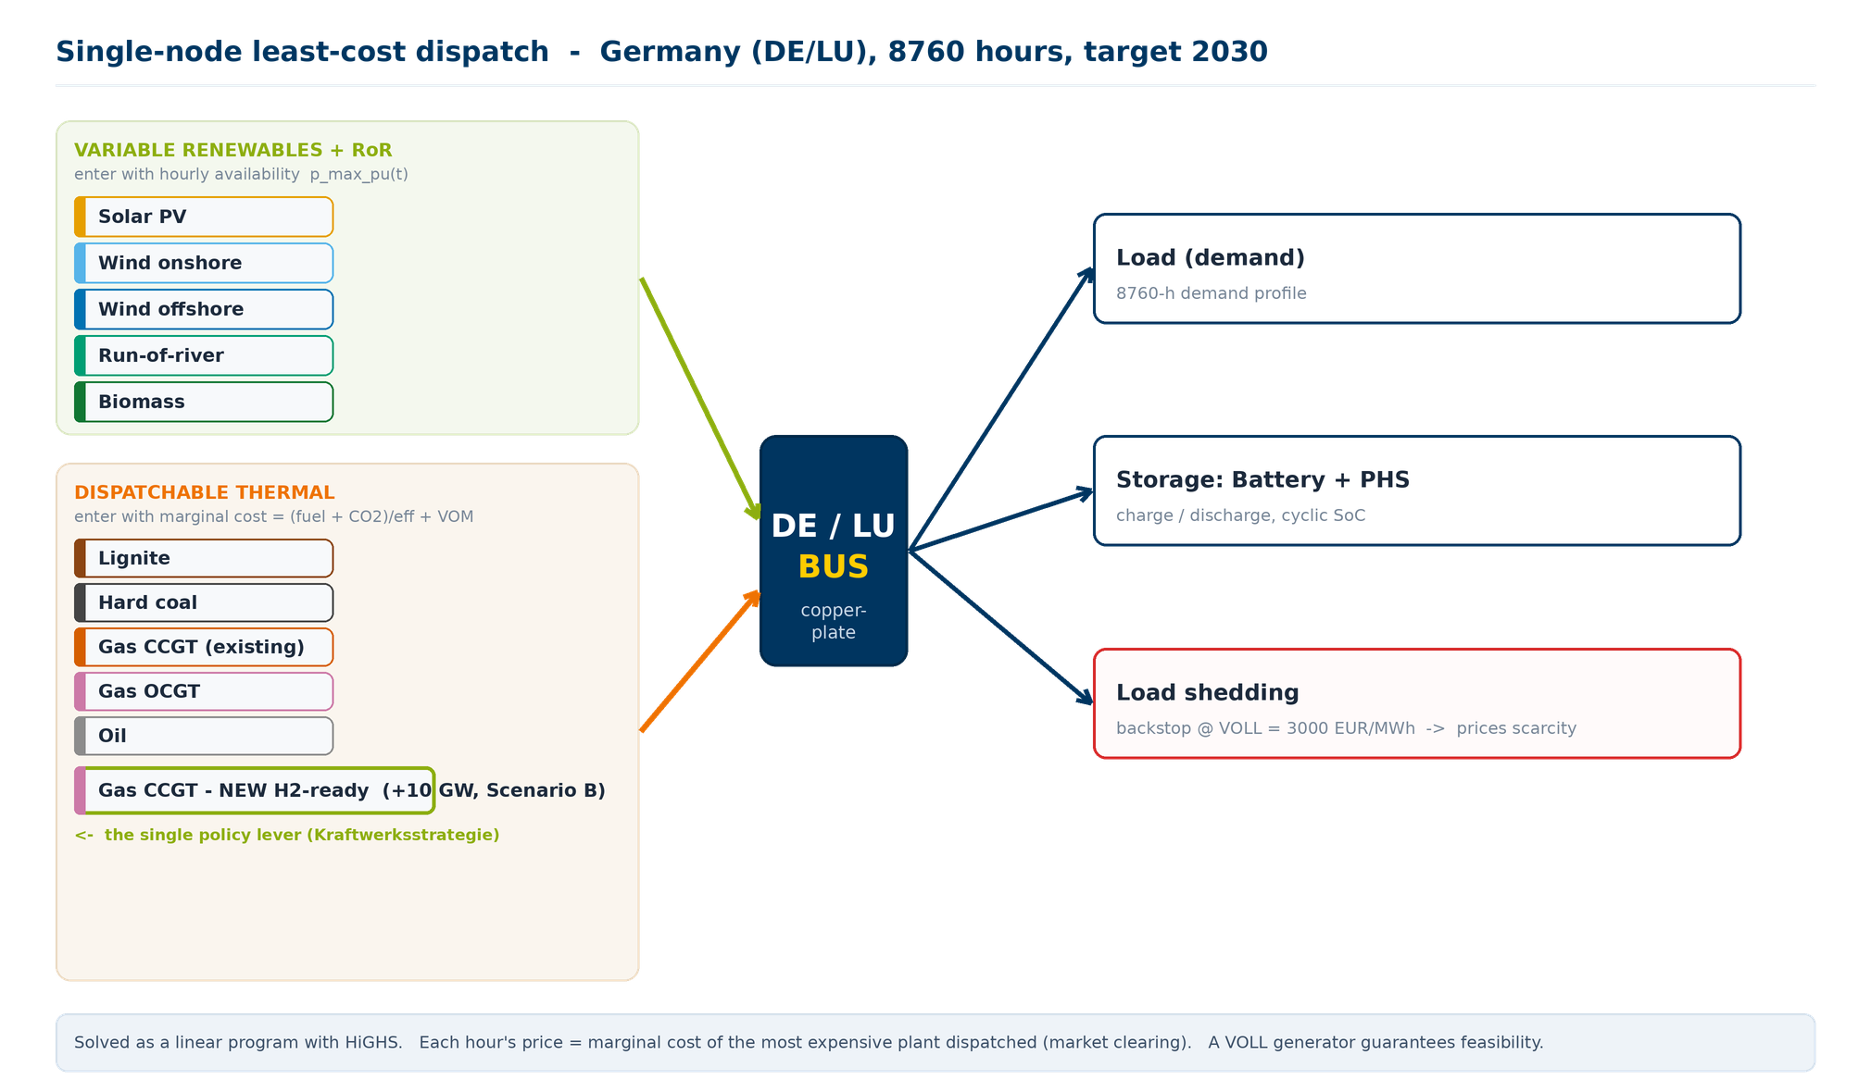
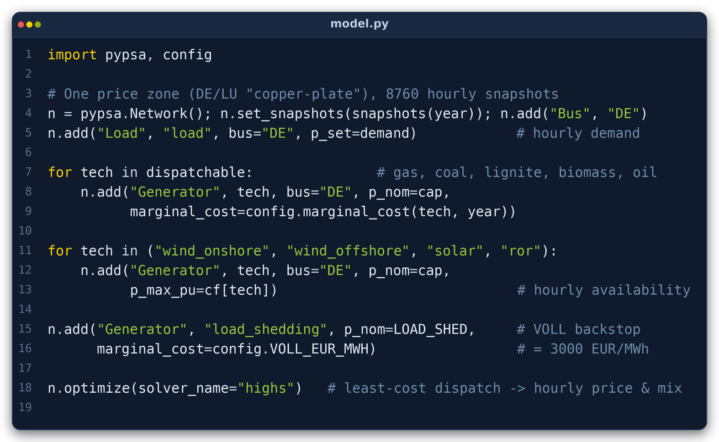
PART 2 · METHODS & WORK PLAN | STEP 3 → MODEL
The Dispatch Model → model.py
A single-node (DE/LU “copper-plate”) hourly linear program in PyPSA, solved with HiGHS. It builds the network one bus, demand, generators (thermal by marginal cost; renewables by hourly availability), storage, a VOLL backstop and capped imports. Then finds the least cost dispatch for all 8760 hours; each hour’s price = the marginal cost of the last plant dispatched.
Model validation: calibrated on real 2025 → modelled mean price €89.72/MWh vs realized €89.33/MWh → 0.4 % error.
Ruhr-Universität Bochum · Chair of Energy Systems & Energy Economics · Kraftwerksstrategie · June 2026
6 / 7

Slide 7
RUHR-UNIVERSITÄT BOCHUM · CHAIR OF ENERGY SYSTEMS & ENERGY ECONOMICS
Full model & code: https://github.com/ahmadayy/RUB-Kraftwerksstrategie.git
Thank you
Questions?
Evaluating Germany’s Kraftwerksstrategie
Two-layer evaluation: CRM literature review + a PyPSA model of the 2030 German power system · June 2026

